Slide 1
Sales Performance Analysis of Walmart Stores Using Advanced MySQL Techniques
Walmart wants to optimize its sales strategies by analyzing historical transaction data across branches, customer types, payment methods, and product lines. To achieve this, advanced MySQL queries will be employed to answer challenging business questions related to sales performance, customer segmentation, and product trends.

Slide 2
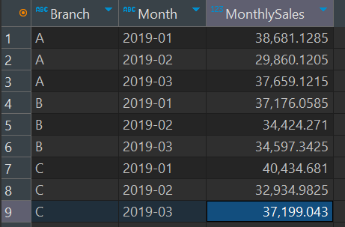
Task 1: Identifying the Top Branch by Sales Growth Rate
SELECT
Branch,
DATE_FORMAT(STR_TO_DATE(Date, '%d-%m-%Y'), '%Y-%m') AS Month,
SUM(Total) AS MonthlySales
FROM walmartsales_dataset wd
GROUP BY Branch, DATE_FORMAT(STR_TO_DATE(Date, '%d-%m-%Y'), '%Y-%m')
ORDER BY Branch, Month;

Slide 3
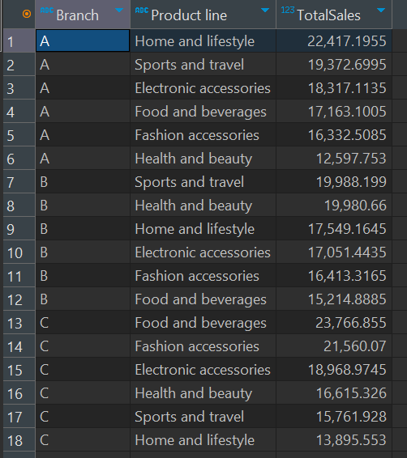
Task 2: Finding the Most Profitable Product Line for Each Branch
SELECT
Branch,
`Product line`,
SUM(Total) AS TotalSales
FROM walmartsales_dataset wd
GROUP BY Branch, `Product line`
ORDER BY Branch, TotalSales DESC;

Slide 4
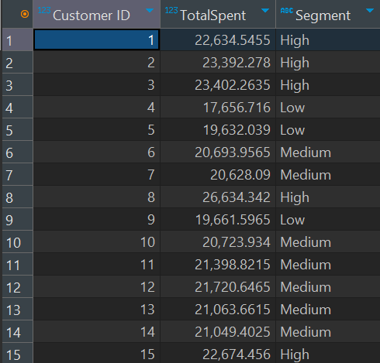
Task 3: Analyzing Customer Segmentation Based on Spending
SELECT
`Customer ID` ,
SUM(Total) AS TotalSpent,
CASE
WHEN SUM(Total) > 22500 THEN 'High'
WHEN SUM(Total) BETWEEN 20000 AND 22500 THEN 'Medium'
ELSE 'Low'
END AS Segment
FROM walmartsales_dataset
GROUP BY `Customer ID`
order by `Customer ID` asc;

Slide 5
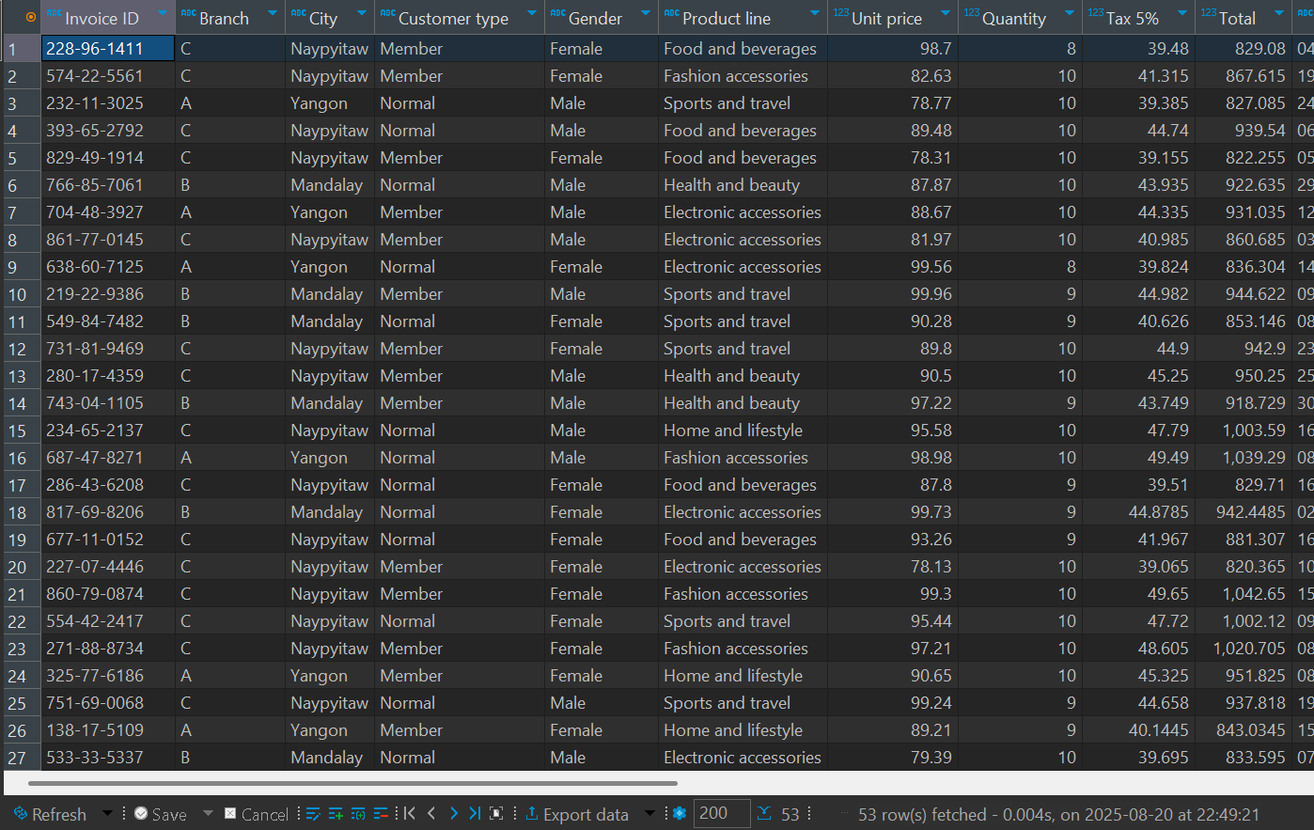
Task 4: Detecting Anomalies in Sales Transactions
SELECT * FROM walmartsales_dataset
WHERE Total > (SELECT AVG(Total) + 2 * STDDEV(Total) FROM walmartsales_dataset)
OR Total < (SELECT AVG(Total) - 2 * STDDEV(Total) FROM walmartsales_dataset);

Slide 6
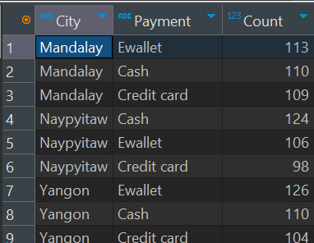
Task 5: Most Popular Payment Method by City
SELECT
City,
Payment,
COUNT(*) AS Count
FROM walmartsales_dataset wd
GROUP BY City, Payment
ORDER BY City, Count DESC;

Slide 7
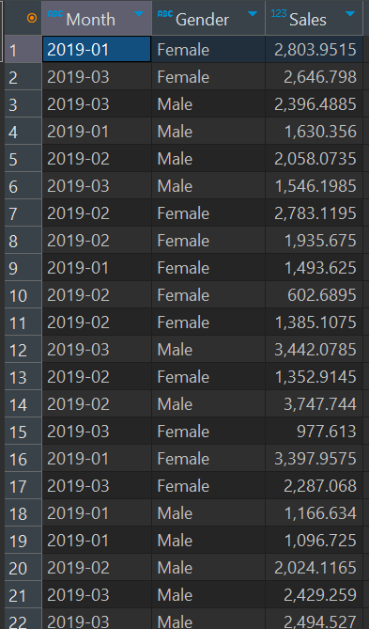
Task 6: Monthly Sales Distribution by Gender
SELECT
DATE_FORMAT(STR_TO_DATE(Date, '%d-%m-%Y'), '%Y-%m') AS Month,
Gender,
SUM(Total) AS Sales
FROM walmartsales_dataset
GROUP BY Date, Gender;

Slide 8
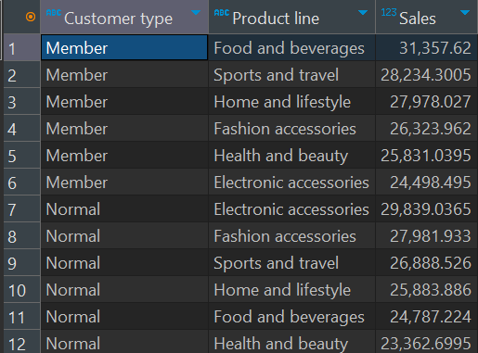
Task 7: Best Product Line by Customer Type
SELECT
`Customer type` ,
`Product line` ,
SUM(Total) AS Sales
FROM walmartsales_dataset
GROUP BY `Customer type` , `Product line`
ORDER BY `Customer type` , Sales DESC;

Slide 9
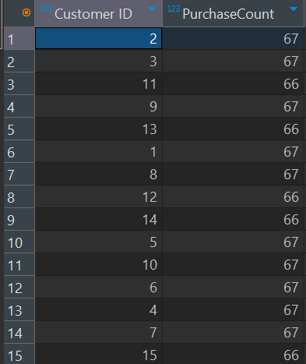
Task 8: Identifying Repeat Customers
SELECT
`Customer ID`,
COUNT(*) AS PurchaseCount
FROM walmartsales_dataset wd
GROUP BY `Customer ID`
HAVING COUNT(*) > 1;

Slide 10
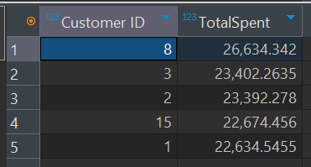
Task 9: Finding Top 5 Customers by Sales Volume
SELECT
`Customer ID`,
SUM(Total) AS TotalSpent
FROM walmartsales_dataset wd
GROUP BY `Customer ID`
ORDER BY TotalSpent DESC
LIMIT 5;

Slide 11
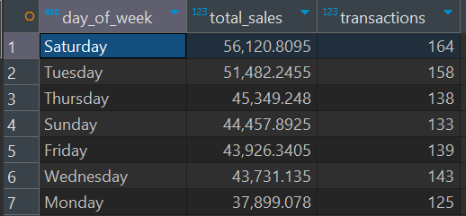
Task 10: Analyzing Sales Trends by Day of the Week
SELECT
DAYNAME(STR_TO_DATE(`Date`, '%d-%m-%Y')) AS day_of_week,
SUM(total) AS total_sales,
COUNT(*) AS transactions
FROM walmartsales_dataset wd
GROUP BY day_of_week
ORDER BY total_sales DESC;

Slide 12
Video Link:
https://drive.google.com/file/d/1RdqXwcyX16IT83eaNU-mT6ayvrYbyjGH/view?usp=drive_link

